Slide 1
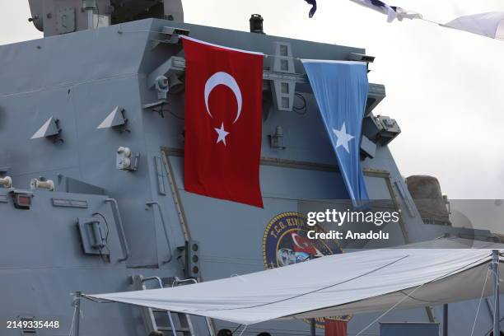
Turkish Cooperation in Somalia's Fishing and Oil Industry

Slide 2
Turkish Cooperation in Somalia's Fishing and Oil Industries
Learning Objectives:
By the end of this session, participants will.
Understand the historical and strategic context of Somalia-Turkey relations.
Recognize Turkey's contributions to Somalia’s fishing and oil industries.
Assess the economic impacts and challenges of this partnership.
Identify mutual benefits and future prospects for both nations.

Slide 3
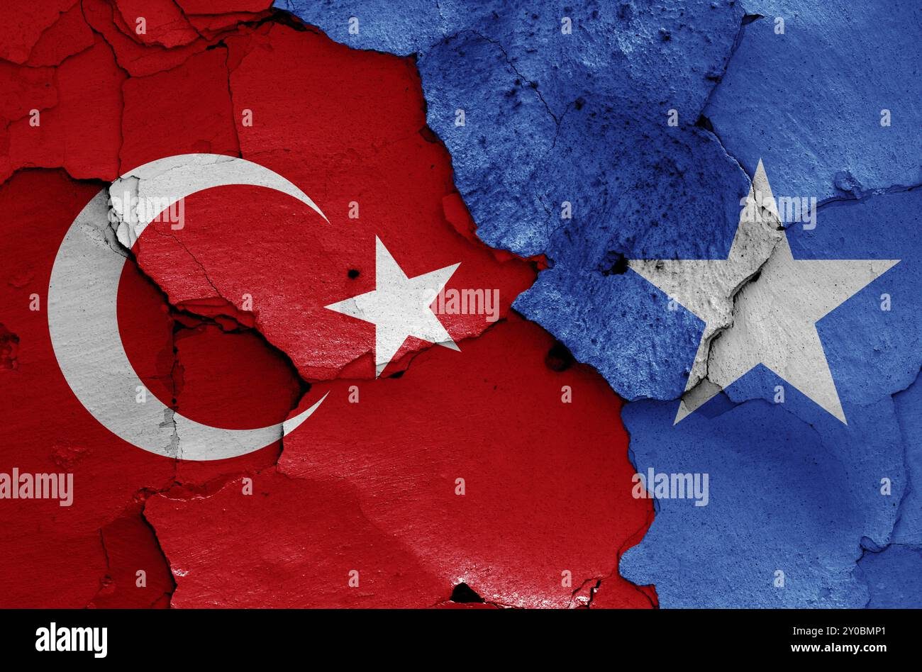
Background of Somalia-Turkey Relations
The partnership between Somalia and Turkey dates back to 2011, when Turkish President Recep Tayyip Erdoğan visited Mogadishu amidst a devastating famine. This visit marked the beginning of robust humanitarian and economic cooperation.
Turkey has since become one of Somalia’s largest development partners, supporting infrastructure development, education, healthcare, and economic growth.
Somalia benefits from Turkey's strategic interests in the Horn of Africa as part of its broader African engagement policy.
3

Slide 4
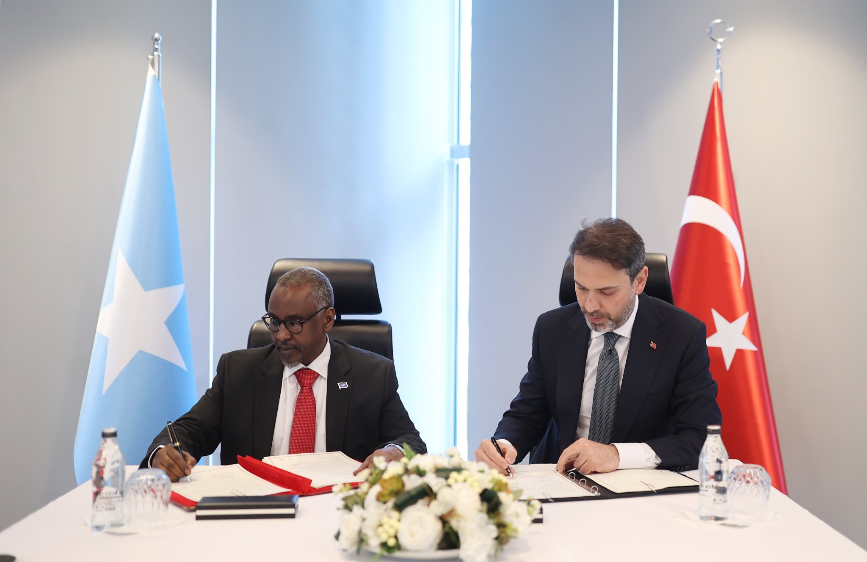
Bilateral Agreements
Turkey has signed trade agreements with Somalia to import seafood, particularly tuna and lobster, directly into Turkish markets.
Turkish firms are helping Somalia build capacity to meet international quality standards, increasing the value of Somali seafood exports.

Slide 5
Fishing Industry Cooperation
Development of Somalia's Fisheries
Turkey has supported Somalia in modernizing its fishing industry by providing equipment, training, and expertise.
Somali waters are among the richest in the world, with untapped marine resources. Turkey helps in sustainable fishing practices.
Trade Agreements :
Turkey imports seafood from Somalia, boosting the local fishing economy.
Turkish companies are involved in building cold storage facilities and processing plants to reduce post-harvest losses.
Maritime Security : Turkish naval forces have assisted in combating piracy, ensuring safe waters for fishing activities.

Slide 6
Oil Industry Cooperation
Exploration of Oil and Gas Reserves
Somalia is estimated to have significant offshore oil and gas reserves, attracting global interest, including Turkey's.
Turkey, through its state-owned company TPAO (Turkish Petroleum), has expressed interest in exploring Somalia’s offshore oil blocks.
Initial seismic surveys and exploratory drilling are underway in collaboration with Somali authorities.

Slide 7
Economic Impact
The revitalization of the fishing sector has created jobs for coastal communities.
Fishing is emerging as a key pillar of Somalia’s post-conflict economy, reducing reliance on foreign aid.
Support for Local Businesses:
Investments in fishing ports, cold storage facilities, and transportation networks have improved infrastructure in coastal regions, facilitating economic growth beyond fishing.
Fishing is emerging as a key pillar of Somalia’s post-conflict economy, reducing reliance on foreign aid and humanitarian assistance.
The growth of the fishing industry allows the government to generate revenue through taxation, which can be reinvested in public services

Slide 8
Challenges and Risks
Political Instability
Somalia's fragile political environment and ongoing insurgency by groups such as Al-Shabaab deter large-scale investments in both the fishing and oil industries.
Turkish companies often operate under heightened security risks.
Environmental Concerns
Overfishing and the absence of effective marine conservation policies threaten the sustainability of Somalia’s fisheries.
Oil exploration and potential spills could endanger Somalia's fragile marine ecosystems.

Slide 9
Mutual Benefits
Benefits for Somalia
Benefits for Turkey
Enhanced infrastructure for fishing and oil extraction.
Job creation in local industries, improving livelihoods.
Increased government revenues through taxes and royalties from resource exports.
Strengthened diplomatic and economic ties with Turkey.
Access to Somalia’s rich natural resources, including fish stocks and hydrocarbons.
Expansion of Turkish influence in East Africa, bolstering its geopolitical ambitions.
Opportunities for Turkish companies to operate in untapped markets.

Slide 10
Key Turkish Contributions in Somalia
Albayrak Group: A Turkish firm managing the Mogadishu port, which is crucial for exporting Somali seafood and other resources.
Turkish Airlines: The first international airline to operate direct flights to Mogadishu, facilitating trade and business connections.
Infrastructure Investments: Construction of modern roads, ports, and processing facilities to support fisheries and oil logistics.

Slide 11
Future Prospects
Fishing Industry
Turkey aims to expand joint ventures with Somali fishing cooperatives to increase exports.
Establishing sustainable marine policies and marine protected areas could safeguard the sector’s long-term viability.

Slide 12
Cont…
Oil Industry
If exploration leads to significant oil discoveries, Turkey could play a leading role in building Somalia’s oil production and refining capacity.
Establishing a transparent revenue-sharing framework between the Somali government, Turkish firms, and local communities is critical to avoiding resource-related conflicts.

Slide 13
Conclusion
Turkey’s cooperation with Somalia in the fishing and oil industries represents a significant step toward rebuilding Somalia’s economy. While challenges persist, the partnership offers immense potential for mutual growth, economic transformation, and strengthened bilateral ties.

Slide 14
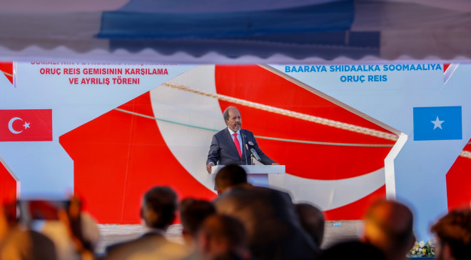
Quote and Image Slide
“
"Turkey is a unique country for Somalia," acknowledging Turkey's unparalleled support in various fields, including security, health, and education”.
14

Slide 15
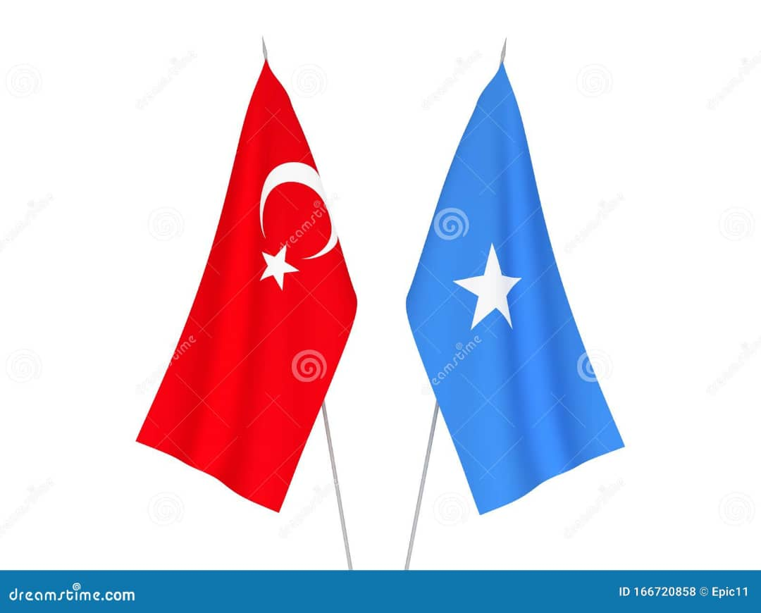
THANK YOU
Insert Image

